Slide 1


Slide 2

LIBRARY MANAGEMENT SYSTEM presented by k. bharathi devi

Slide 3
LIBRARY MANAGEMENT SYSTEM
This Project is Library Management System. It includes all Library works, such as Maintaining Books and Members details, Issue Books, returns from the Members and at the end of the day generate Issue and Return reports. These works are done by the Librarian.

Slide 4
Software Requirements:
Web Presentation : CSS
Client – side Scripting : JavaScript
Programming Language : Java
Web based Technologies : Html, Servlets
Database Connectivity : JDBC
Java Version : JDK 1.6
Backend Database : MY SQL
Operating System : Windows7/ XP/2000/2003,LINUX
Web Server : Tomcat 7.0
Browser : Mozilla Firefox

Slide 5
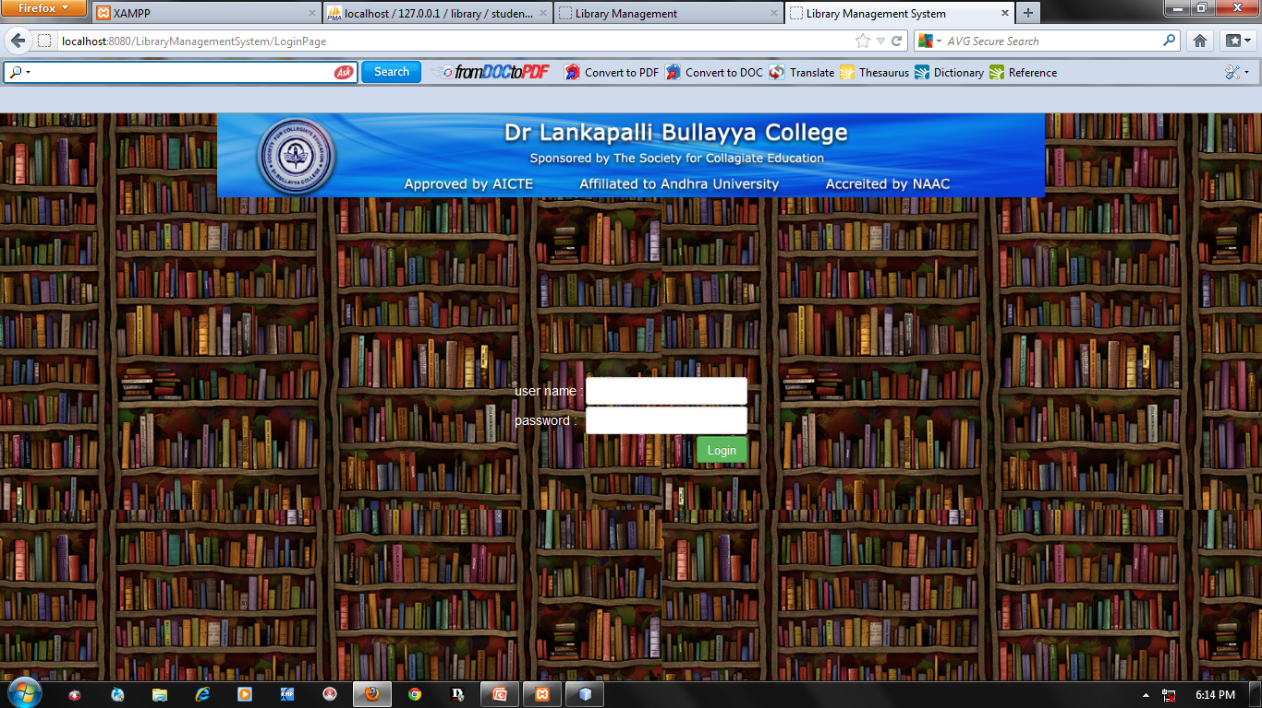
LOGIN FORM:

Slide 6
USERS: Admin & Clerks

Slide 7
Admin functionalities
Create Clerk
Book Entry
Staff Entry
Student Entry
Book Issues
Book Returns
Fine collection
All Reports

Slide 8
Clerk Functionalities
Book Entry
Student Entry
Staff Entry
Book Issues
Book Returns
Fine Collection

Slide 9
Clerk Creation
INPUTS: FullName,Qulification,Username,password etc.
OUTPUT:-
Created clerk successfully
Edit clerk successfully
Updated clerk successfully
VALIDATION:
If we are submit without filling details, then it will show “please fill all the details”.

Slide 10
Book Entry
INPUTS: Title, Author, subject….etc.
OUTPUT:
Data stored successfully
Edit Book successfully
Updated Book successfully
VALIDATION:
If the Book is edit then it will show the total No. of Books and how many Books are issued.

Slide 11
Student Entry
INPUTS: Name, Branch, Admission No etc.
OUTPUT:
Student Entry successfully
Student Entry Edit Successfully
Student Update successfully

Slide 12
Staff Entry
INPUTS: Name,Designation,……..etc.
OUTPUT:
Staff Entry data stored successfully
Staff Edit successfully
Staff Update successfully

Slide 13
Book Issues
INPUTS:Member Id,Book Id,….etc.
OUTPUT:
Book Issued successfully.
For every student 3 books issued only.
For every staff 5 books issued only.
Validation:
If Books are over, it will displays already all books are issued.
Same Book can’t be issued twice.
Some limitation of Books are issued to the member.

Slide 14
Book Returns
INPUTS:Member Id, Book Id,……etc.
OUTPUTS:
Book Returns successfully.
The Book Return with in 15 days.
Validation:
For Student: If Book issued date is greater than 15 days than Fine will shown on the screen.
For Staff: There is no Fines for Staff.

Slide 15
For All Reports
INPUT:
Today’s Report
Weekly Report
Monthly Report
Year Report
Between dates
OUTPUT: All Reports showed successfully.

Slide 16
Copy rights reserved
BY
Dr.L.BULLAYYA COLLEGE

Slide 17

THANKING YOU

